Slide 1
Chapter 21
Data Center Architecture and Cloud Concepts

Slide 2
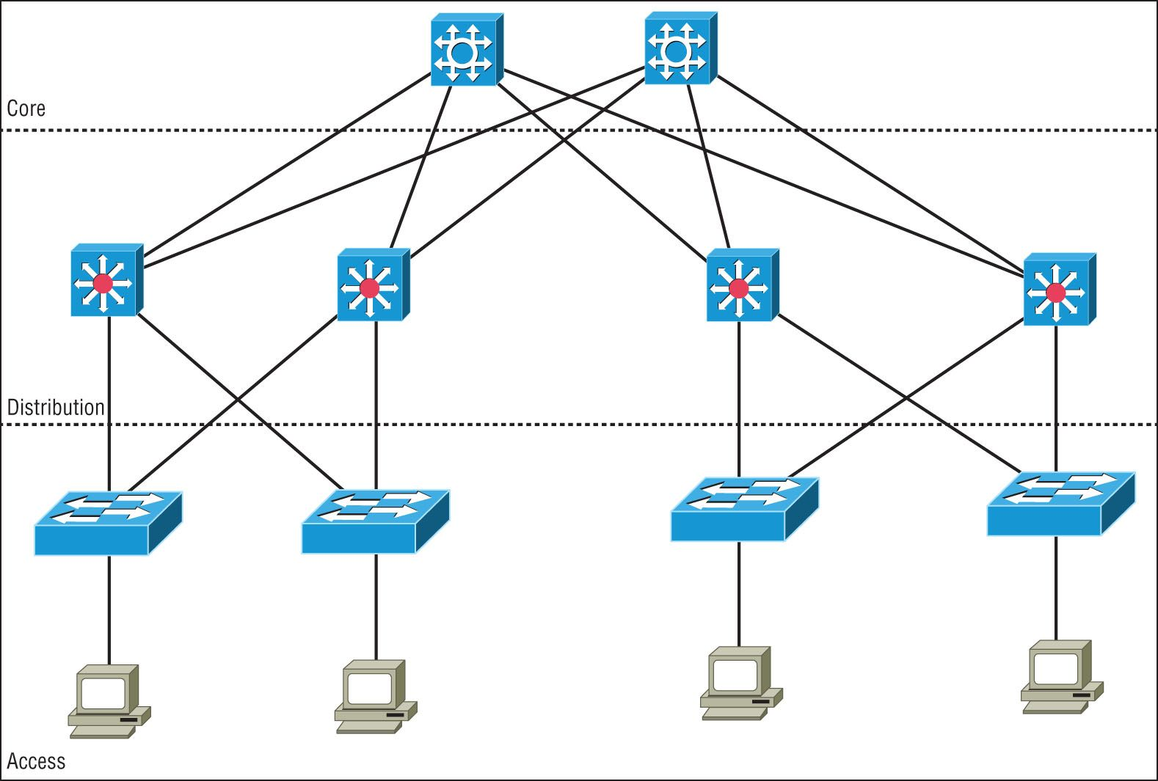
Three-tiered
Core
Provides interconnectivity between all network pods in the data center
Distribution/aggregation
Provide redundant connection, connect to the core, and implement security, access control and layer 3 routing
Access/edge
Devices attach to the network
Notes:
Core: the center of the network; web servers, databases, and applications
Many people need access to this layer
Distribution Layer: midpoint between the core and the users; manages the path of the network to the users. COMMUNICATION BETWEEN SWITCHES
Access/Edge: where the users are located; workstations and printers

Slide 3
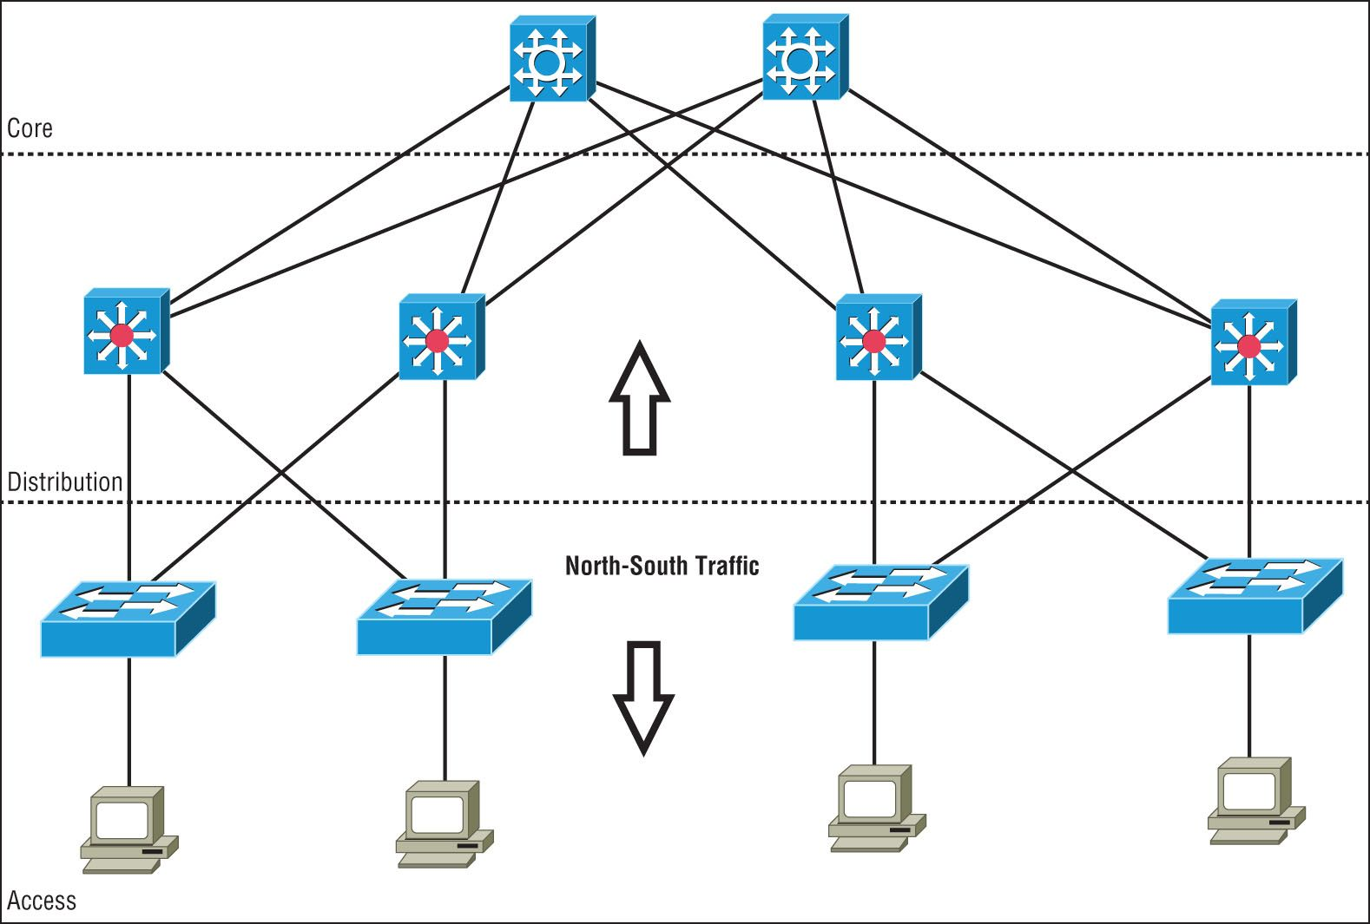
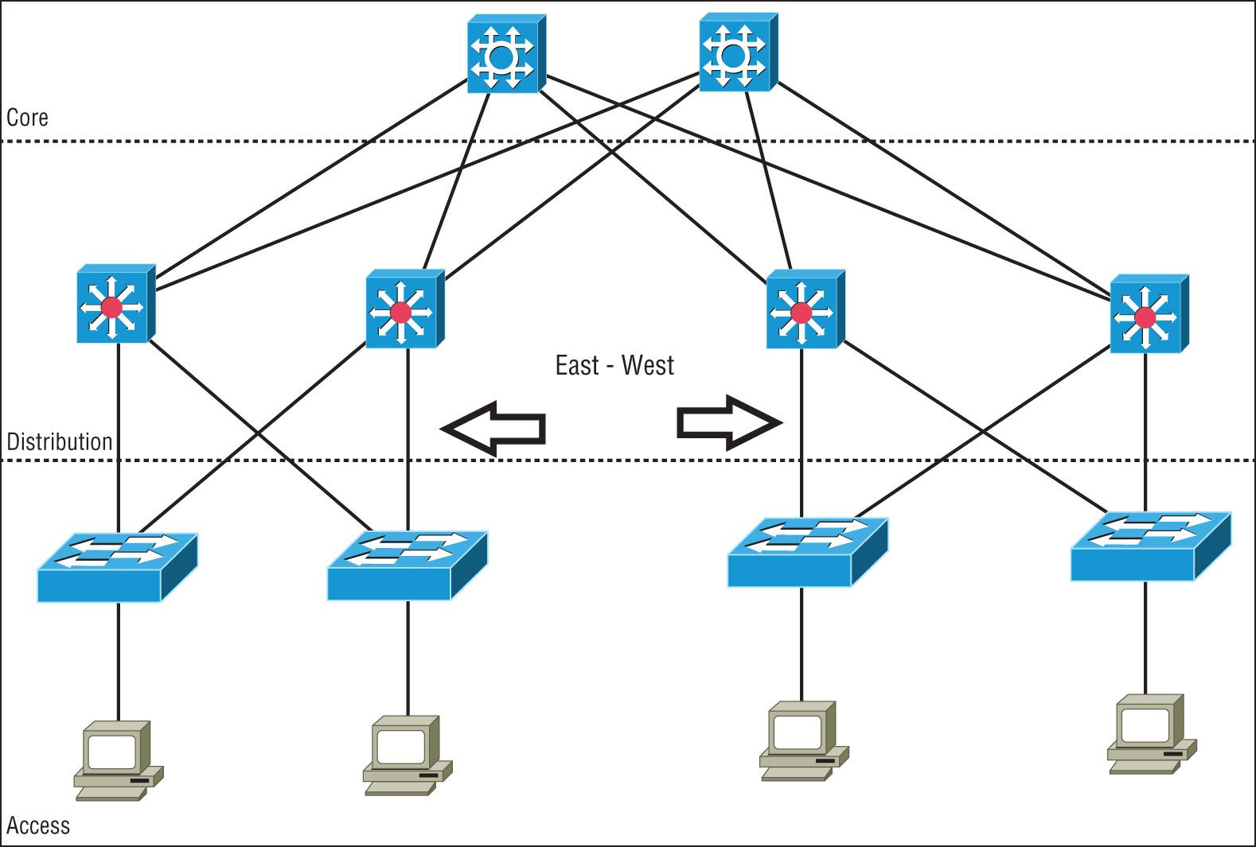
Traffic Flows
North-South
Refers to traffic entering and leaving the data center
East-West
Traffic that flows inside the data center between devices
Notes:
North-South traffic is entering or leaving the data center
East-West is traffic and data that is being sent between devices within the data center

Slide 4
Software-defined Networking
Network devices are managed as complete set and not individually from a central controller
Application Layer
Standard network applications like IDS/IPS, load balancers, proxy servers, etc
Explicitly or programmatically communicate to the SDN Controller
Control layer
Management Plane
Processes configuration, monitoring, and other application-specific information between the application and infrastructure layers
Infrastructure Layer
Forwarding Plan
Consists of network hardware controlling the forwarding and processing for the network
Collects network health information
Notes:
SDN: combines the functionality of data, control, and management to one centralized device or controller
Takes all the different functions of different devices and combines them into one to operate separately logically
Application layer: includes firewalls, IDS/IPS, Load balancers
Control layer: acts as the SDN controller, manages the traffic flow
Infrastructure layer: made up of the physical switches and routers

Slide 5
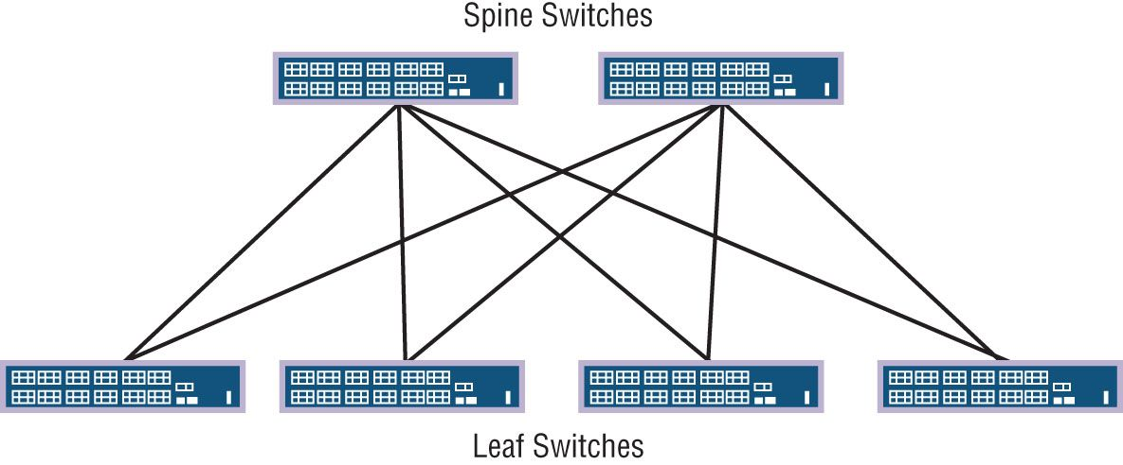
Spine and Leaf
Datacenters are evolving to a two-tier architecture
The two-tier architecture offers the following advantages over the traditional three tier designs.
Resiliency
Each leaf switch connects to every spine switch
Latency
Ultra low
Maximum 2 hops over a high-speed network for east-west traffic
Performance
Active-active up-links allow traffic to flow over the least congested available link
Scalability
Easy to add leaf switches for port capacity and spine switches for uplinks
Adaptability
Multiple networks are often managed from SDN controllers
Notes:
Each leaf switch connects to each spine switch
Leaf switches and spine switches don’t connect directly to each other

Slide 6
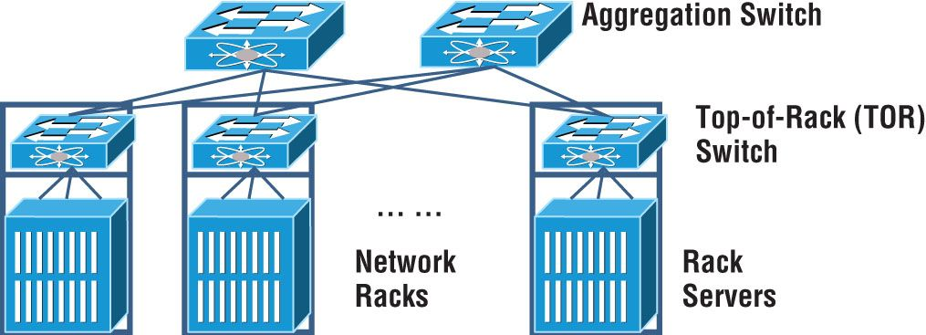
Top-rack switching
Place access switches at the top of the rack
Connects to distribution or spine and leaf with high-speed links from 10G up to 100G
Advantage is lower-cost copper or coaxial cable is used and confined to the rack
Notes:
Top-rack switching: each leaf switch is on top of a physical network rack
Good for cabling, its redundant, and fast. When adding to your network its costly

Slide 7
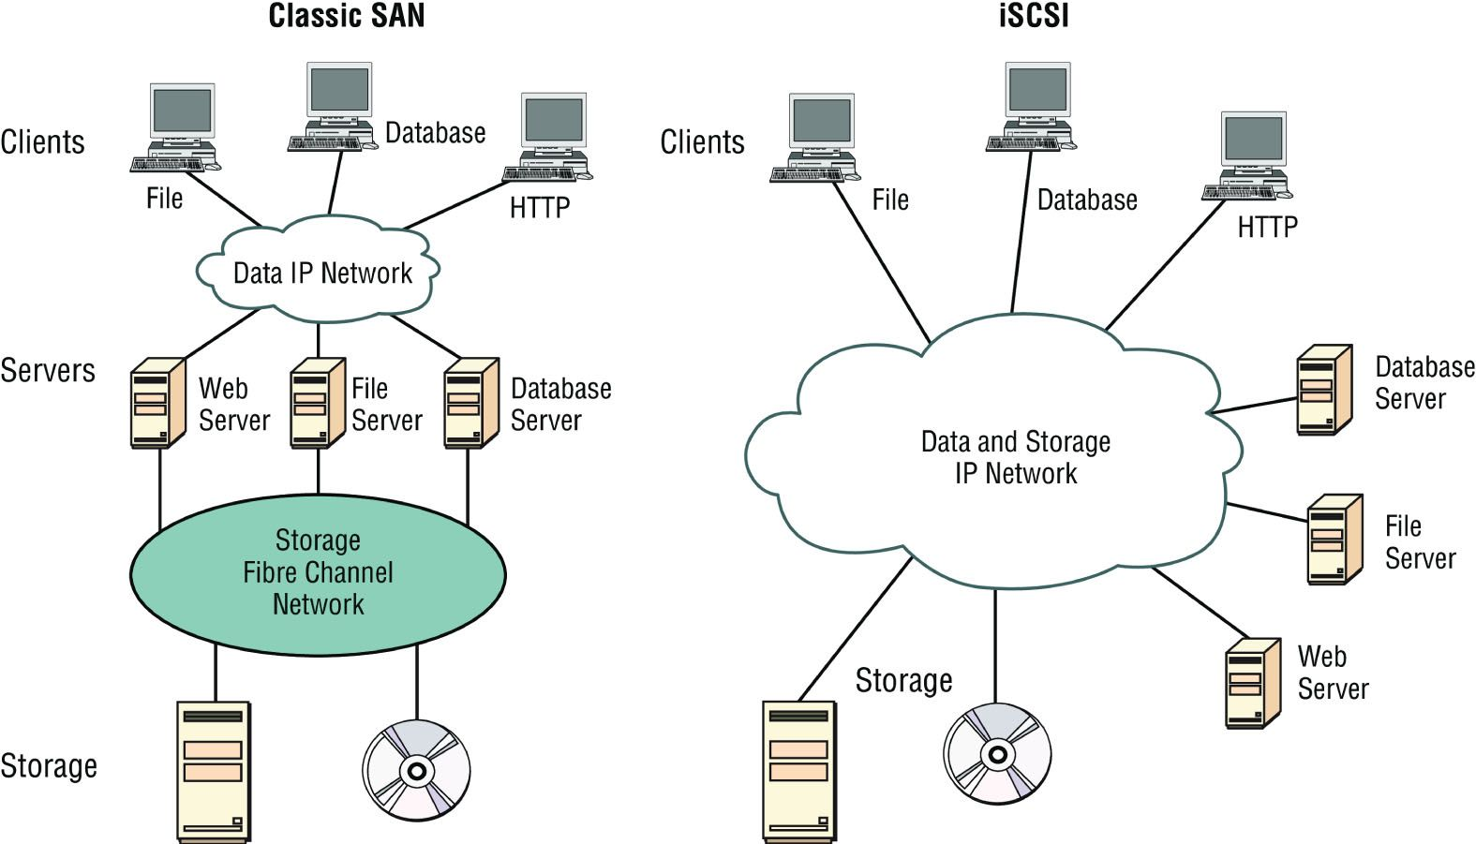
Storage Area Networks
Separate private network of storage devices
Connection Types
Fiber Channel over Ethernet (FCoE)
Encapsulates fiber channel frames within ethernet frames
Allows traffic on the IP network
Fiber Channel
Used to connect computer data storage
2, 4, 8, 16Gbps
Not compatible with the regular IP based data network
Internet Small Computer Systems Interface (iSCSI)
IP-based standard method for encapsulating SCSI commands within IP Packets
Can use the same network for storage and data
Notes:
SAN: high-capacity storage devices that are connected by a high-speed private network separate from the LAN
Data collection, data management, and the use of data
Very efficient at reading and writing
Block-level access so if you have a large file, you can rewrite part of the data without having to overwrite the entire file
Requires a lot of bandwidth, usually has it own network
Fibre Channel: Allows you to connect servers and storage together at very high speeds
You need a Fibre channel switch
FCoE: If you don’t have a Fibre channel interface on a server, usually integrates with an existing Fibre channel infrastructure
Not routable
iSCSI: Makes a remote disk, look and operate like a local disk; can be managed in software instead of hardware

Slide 8
Branch Office vs. on-premises datacenter vs co-location
Deciding to where to place a datacenter can be a daunting task.
Do I want it closer to the user, do I want to build and manage a datacenter or do I want to lease space
Branch Office
Puts data closest to the user.
No remote links
On premise
Separate datacenter that has its own staff
Can be resilient to environmental considerations(backup Datacenter)
Co-location
Provider builds out datacenter and leases space

Slide 9
Cloud Deployment Models
Public Cloud
Providers deploy infrastructure and then make it accessible to any customers who wish to take advantage of it in a multitenant model
Private Cloud
Used to describe any cloud infrastructure that is provisioned for use by a single customer
Community Cloud
Run in a multitenant environment, but the tenants are limited to members of a specifically designed community
Hybrid Cloud
A catch-all term used to describe cloud deployments that blend public, private, and/or community cloud services together

Slide 10
Service Models
IaaS – Infrastructure as a Service
Building blocks for IT
Network, Compute, Storage
Very Flexible
PaaS – Platform as a Service
No need to manage underlying infrastructure
Focus on deployment and management
SaaS – Software as a Service
Ran and managed by the service provider

Slide 11
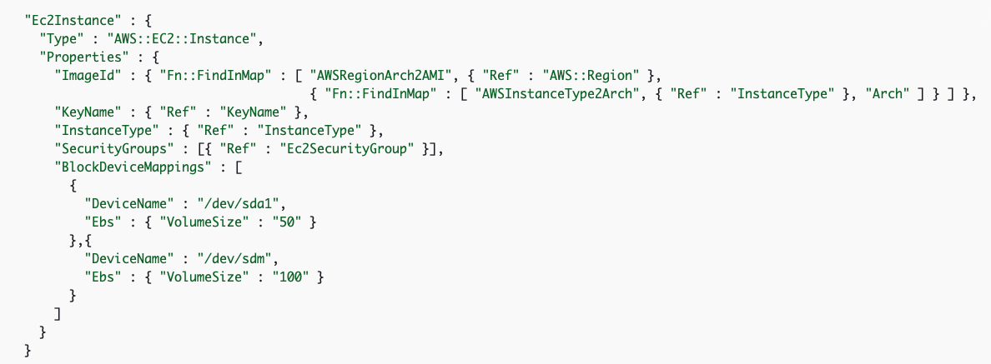
Infrastructure as Code
Process of automating the provisioning, management, and deprovisioning of infrastructure services through scripted code rather than human intervention.
The major advantages to using an IaC approach
Increasing the reusability of code
Reducing the time spent by operations team creating infrastructure components
Increasing the speed of infrastructure creation
Reducing the likelihood of configuration errors by leveraging common templates
Notes:
You use coding to build the infrastructure of your servers, routers, and networks
When you make updates, you just update the code
You can use the same code to make multiple instances of the same application, switch, or router
Copy-paste-create
AUTOMATE EVERYTHING!

Slide 12
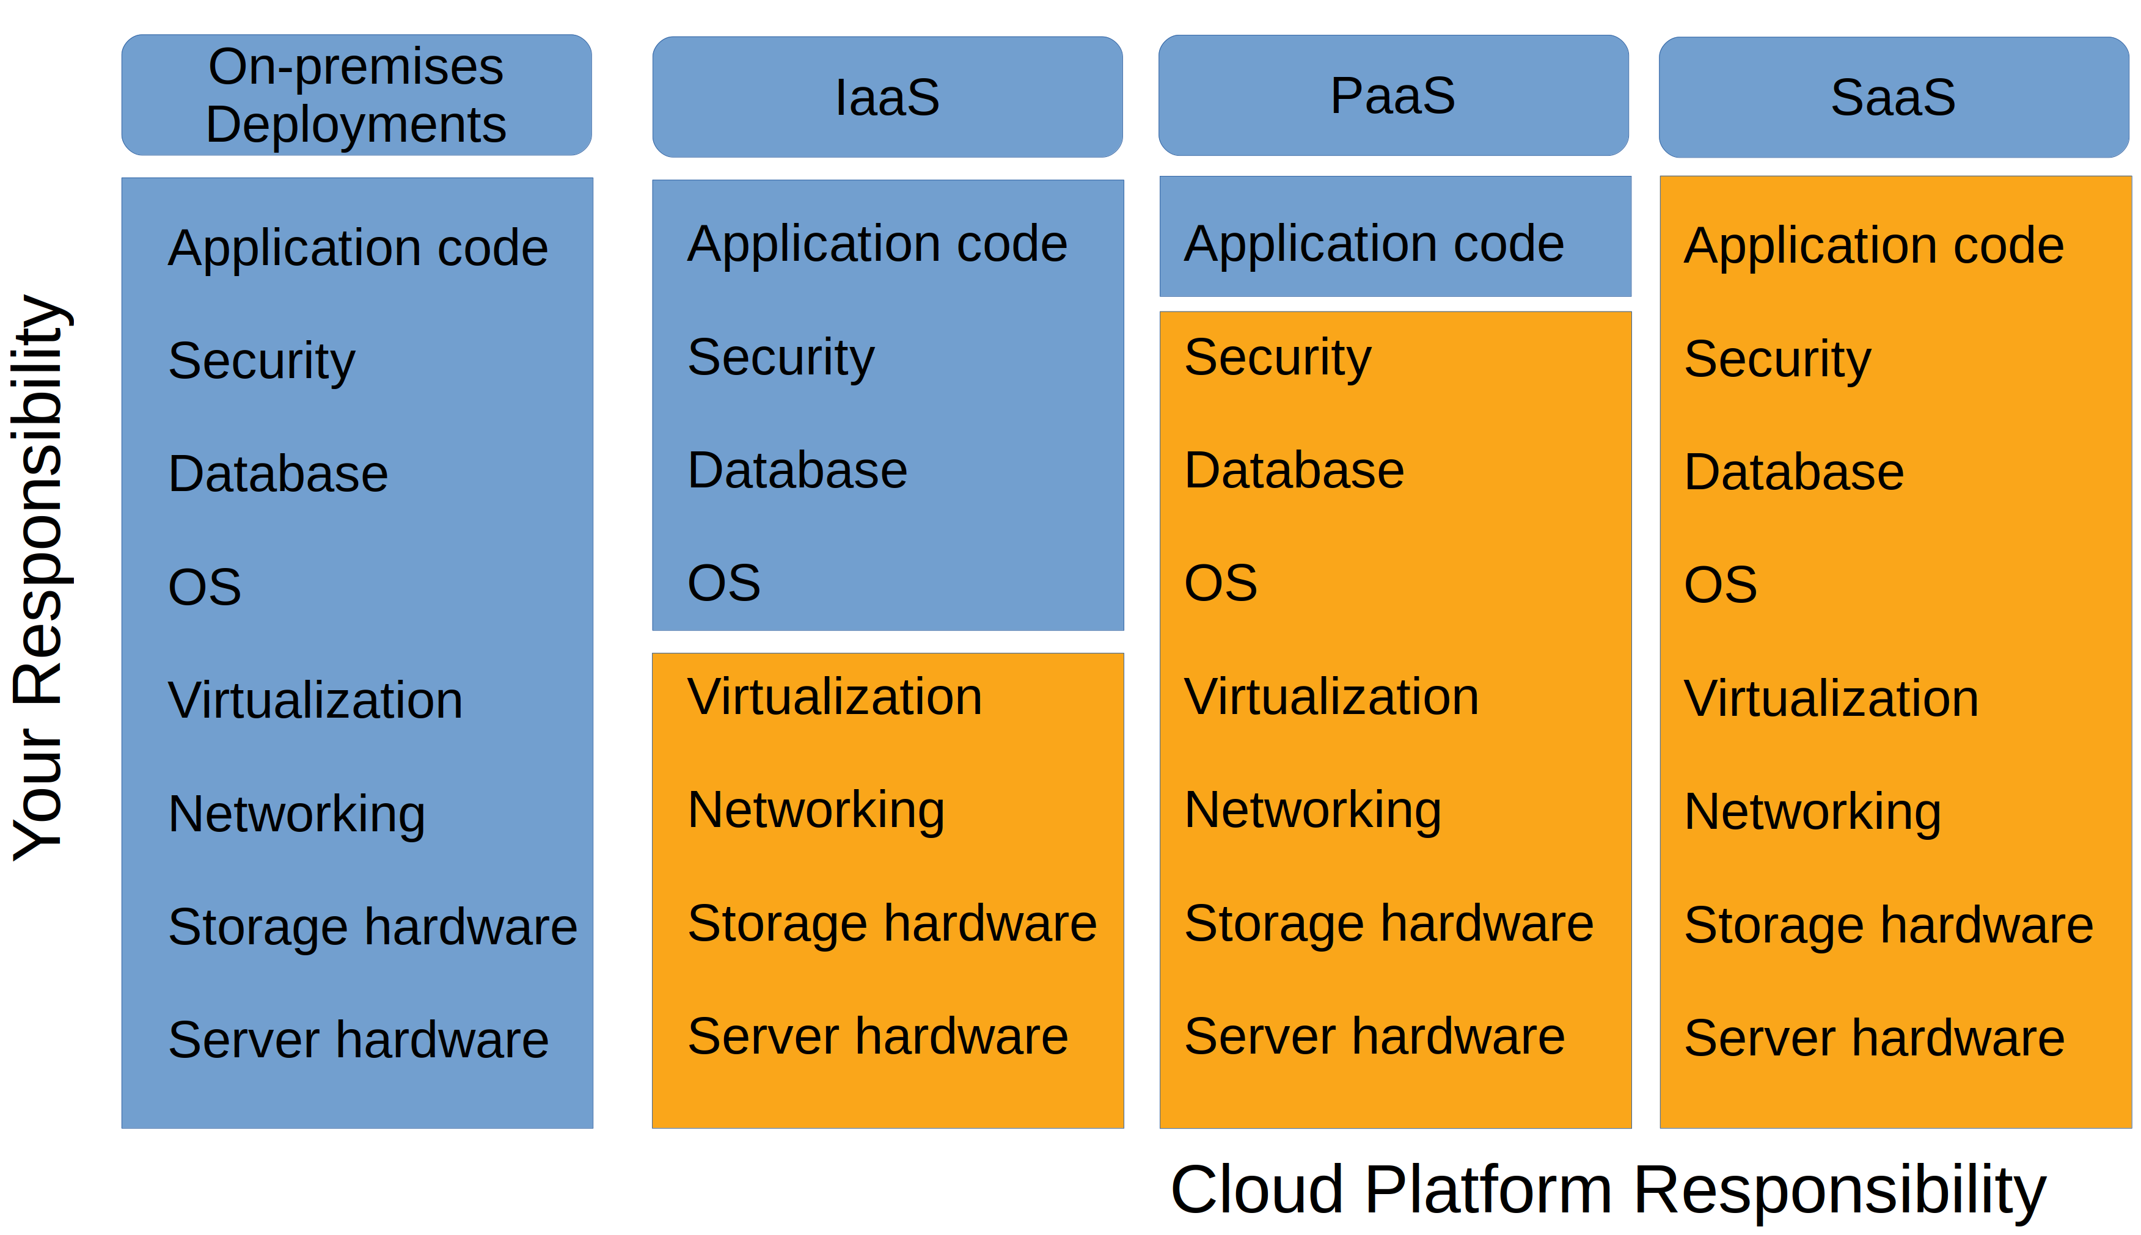
The breakdown of responsibility across multiple cloud models

Slide 13
Connectivity Options
VPN
Direct Connect
Multitenancy
Elasticity
Scalability
Notes:
Direct Connect: a dedicated circuit can be ordered and installed between your data center and an interconnection provider or directly to the cloud company

